Slide 1
The Scale and Potential of Wood Heat: Why Everyman’s Renewable Will Outpace Solar
John Ackerly
President,
Tatiana Butler,
Program Director
Notes:
Intentionally provacative, and I chose it because wood heat gets so little attention and respect in the renewable energy arena.

Slide 2
About the Alliance & Transforming Wood Heat
Transforming Wood Heat in America: A Toolkit of Policy Options
The Alliance is non-profit, 501c3 organization
Project Funding: Forest Service’s Wood Education and Resource Center (WERC), foundations, companies and individuals
Based on 150 interviews with state and local officials
Guided by Task Force from non-profits, industry & government
Full report available at: www.forgreenheat.org/resources/toolkit.html
Notes:
First, I wanted to thank the Wood Education and Resource Center for believing in us. I especially want mention Al Steele, who always admonishes me to keep in mind the rural poor.

Slide 3
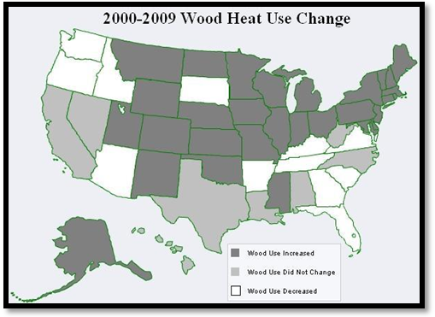
Overview – Prevalence of Wood Heat
Transforming Wood Heat in America: A Toolkit of Policy Options
10% of American homes heat with wood. (US Census)
Wood heaters make 80% of residential renewable energy (EIA).
13 million wood heaters in use (EIA).
Wood heat rose 50 – 80% in 6 states from 2000–2009. (US Census)
Full report available at: www.forgreenheat.org/resources/toolkit.html
Notes:
Connecticut, Massachusetts, Michigan, New Jersey, Ohio and Wisconsin, the number of Americans heating with wood rose between 50 – 80%.
Finally the class of non-EPA certified wood burning appliances that compose the majority of current installations are the primary air quality culprits’ and change out programs designed to replace these units with more modern appliances require incentives- much like cash for clunkers.

Slide 4
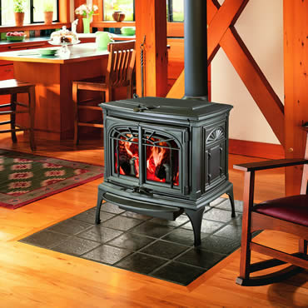
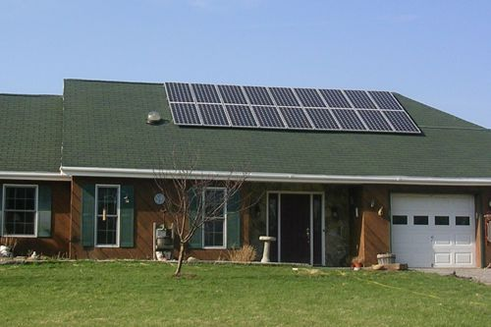
Fossil Fuel Reduction of a $3,000 Wood/Pellet Stove = Fossil Fuel Reduction of a $30,000 Solar PV
Transforming Wood Heat in America: A Toolkit of Policy Options
Both systems can displace equal amounts of carbon from fossil fuel: 3 tons.
1 kw system, 1 cord of wood or 1 ton of pellets all displace about 1 ton of carbon from fossil fuels.
Full report available at: www.forgreenheat.org/resources/toolkit.html
Notes:
The wood or pellet appliance can have the same fossil fuel displacement as the much more expensive solar panel. Under current Federal tax code, solar panels receive a 30% of total cost tax credit, while the maximum deductable for a wood stove is a capped $300. Many state governments overlook wood and pellet stoves entirely. In short the government could be receiving much higher carbon displacement per incentive dollar spent.

Slide 5
Wood Stoves vs. Solar PV & the Prius
Transforming Wood Heat in America: A Toolkit of Policy Options
Technology | # of appliances installed as of 2010 | Tons of carbon saved per year per appliance | Total tons of carbon saved per year in US
Pre 1990 stoves | 6 million | 1.5 tons | 9 million
EPA certified stoves | 3 million | 1.9 tons | 5.7 million
Pellet stoves | 1 million | 3.5 tons | 3.5 million
Total stoves | 10 million | 1.8 tons | 17.7 million
Solar PV panels (4 kw) | 0.3 million | 3.5 tons | 1.05 million
Prius | 0.8 million | 3.75 tons | 3 million
Full report available at: www.forgreenheat.org/resources/toolkit.html
Notes:
Solar Energy Industries Association (SEIA) hopes for 2,000,000 homes to be powered by solar by 2015 – assuming the generous tax credits continue.

Slide 6
Transforming Wood Heat in America
Transforming Wood Heat in America: A Toolkit of Policy Options
Goals:
Transition to clean & affordable appliances
EPA, USDA, state gov’ts help the transition
Utilize incentives to speed up transition
Full report available at: www.forgreenheat.org/resources/toolkit.html

Slide 7
Typical (& Flawed) US Emission Chart
Transforming Wood Heat in America: A Toolkit of Policy Options
PM2.5 levels from biomass stoves accurate
Levels from fossil furnaces grossly underestimate emissions
Life-cycle, not just point of combustion emissions, must be accounted for
Full report available at: www.forgreenheat.org/resources/toolkit.html

Slide 8
Transforming Wood Heat in America: A Toolkit of Policy Options
Funding | State | Objective | Amount
Rebate | NH | Renewable Energy/ Industry | 30% to $6,000
 | VT | Air Quality | $1,000-$6,000
Tax Credit | OR | Energy Efficiency/renewable energy | 25% to $300
 | MT | Renewable Energy | $500
Tax Deduction | AL | Renewable Energy | 100%
 | AZ | Air Quality | $500
 | ID | Renewable Energy, Air Quality | $20,000
Property Tax Exemption | NH | Renewable Energy | 100%
 | NY | Energy Efficiency | 100%
 | MT | Renewable Energy | $20,000
Sales Tax Exemption | VA | Industry | 100%
Low Interest Loan | ID | Energy Efficiency | $1,000-$15,000
 | KS | Energy Efficiency | $20,000
 | MT | Renewable Energy | $60,000
 | NE | Energy Efficiency | $35,000 - $75,000
 | NY | Energy Efficiency | $2,500-$20,000
Full report available at: www.forgreenheat.org/resources/toolkit.html
Notes:
There are currently 16 active effective wood heat incentive programs. While this is in some ways an encouraging example of progress, it is unfortunate that many other state renewable energy incentive programs over look wood heat. The rebate programs are most attractive to low income consumers and have the most potential to drive the market place. The tax programs have less of an immediate budget impact, and require less administrative support, but often need to be coupled with additional incentives to drive 1st time purchasers. Generally tax incentives act more to steer customers already interested in wood or pellet heat towards the cleanest and most efficient appliances. The low interest loan programs are attractive to the states with the capital to set them up since they are self sustaining. Almost all of the existing low interest loan programs are larger energy efficiency loan programs that happen to include wood stoves. Unfortunately many other programs do not. Making wood heating devices eligible is a fairly simple policy fix that can do much to support consumers. Please consult the full version of the toolkit to learn more about each of these programs, and their pros and cons.

Slide 9
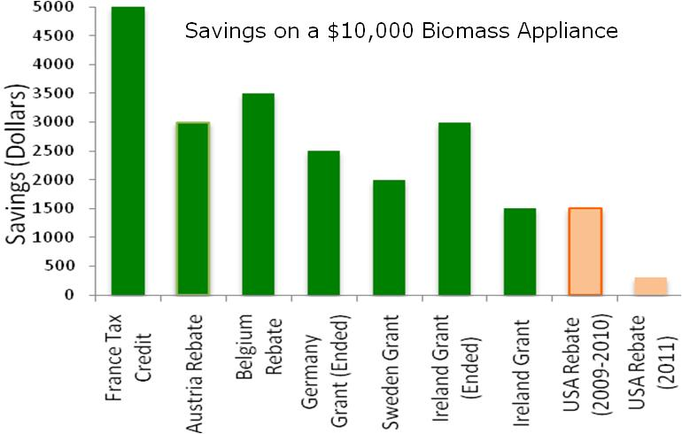
Transforming Wood Heat in America: A Toolkit of Policy Options
Incentives in Europe vs. the US
Full report available at: www.forgreenheat.org/resources/toolkit.html
Notes:
There are few Federal Programs to support wood or pellet heating in the US. This is very likely a large reason so many states overlook such an affordable method to increasing the renewable energy installations in the state. In this renewable energy sector, the US lags far behind most of Europe which is capitalizing off of this cost-efficient way to reduce their carbon foot print.

Slide 10
Recommendations
Transforming Wood Heat in America: A Toolkit of Policy Options
Renewable Energy Incentives: Cleanest appliances should qualify for 30% tax credit like solar, wind and geothermal
EPA’s New Source Performance Standards for wood burning appliances: Stricter and mandatory emission and efficiency standards are needed in America for all major wood burning appliances.
Research & Development: EPA, USDA and DOE needs to start supporting research and development of next generation thermal biomass systems.
Energy Star: An Energy Star programs for wood and pellet stoves is needed to steer consumers toward the cleanest and most efficient appliances
Low Income Heating Assistance: LIHEAP programs should aggressively support change-outs of wood stoves for families on heating assistance. EPA, USDA and HHS collaboration could speed this up.
Full report available at: www.forgreenheat.org/resources/toolkit.html

Slide 11
To find out more:
Transforming Wood Heat in America: A Toolkit of Policy Options
www.forgreenheat.org/toolkit
Full report available at: www.forgreenheat.org/resources/toolkit.html
Notes:
While solar and other more expensive renewable energy systems are a valuable component of our renewable energy portfolio, wood and pellet heat have too long been overlooked as a valuable supplement to increasing our energy independence. What’s more this technology supports local industries, creates green jobs, and is affordable to everyday Americans.

